Slide 1
Telecom customer churn
Business analytics case study
AJETUNMOBI MARIAM

Slide 2
BUSINESS PROBLEM STATEMENT
Customer churn poses a significant challenge to telecommunications companies because it leads to lost revenue, increased customer acquisition costs, and reduced profitability. Analysis of the dataset revealed an overall churn rate of 26.54% ,highlighting the need to understand why customer leaves and identify the factors influencing churn.
Key questions:
Why are customers leaving the company?
Which customer segments have the highest churn rates?
What factors are most strongly associated with customer churn?
Which combination of internet service, tenure, and payment method are associated with highest churn rate?
What actions can the company take to improve customer retention?

Slide 3
DATASET OVERVIEW
The dataset contains information about customers of a telecommunications company and was used to analyse customer behaviour, identify churn patterns, and uncover factors influencing customer retention.
Key data categories:
Customer Demographics: gender, senior citizen, partner, Dependents
Customer account information: tenure, contract, paperless billing, payment method
Services subscribed: Phone services, multiple lines, internet services, online security, online backup, device protection, tech support, streaming TV, streaming movies
Billing and revenue information :monthly charges, total charges
Customer identifier: customer id
Target variable: Churn
Number of rows | 7,043
Number of columns | 21
Churn rate | 26.54%
Churned | 1,869
Retained | 5,174

Slide 4
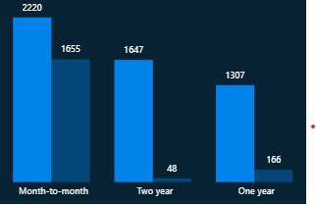
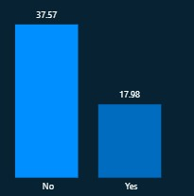
CONTRACT TYPE & TENURE
Contract type and churn
Key findings:
Month-to-month customers had the highest churn rate, indicating that customers with shorter contract commitments are more likely to leave the company
Tenure and churn
Key findings:
Churned customers had an average of 17.98 months compared to 37.57 months for retained customers, indicating that customers are more likely to leave during early stages of their relationship with the company

Slide 5
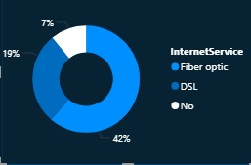
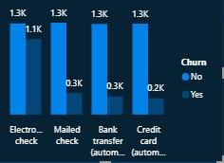
INTERNET SERVICE & PAYMENT METHOD
Internet service and churn
Key findings:
Fibre Optic customers had the highest churn rate, which suggests many customers may not be satisfied with the value they are getting from the service.
Payment method and churn
Electronic check users recorded the highest churn rate, showing this group is more likely to leave than customers using other payment methods. This makes them a key segment that the company should focus on retaining.

Slide 6
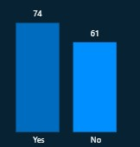
MONTHLY CHARGES
Monthly charges and churn
Key findings:
Customers who churned had higher average monthly charges than retained customers, indicating that pricing may be an important factor influencing customer churn

Slide 7
RECOMMENDATIONS
There is a need to review pricing strategies and strengthen the value proposition for higher paying customers. This can be achieved through service improvements, target retain offers, loyalty programs that help customers perceive greater value from the services
Introduce customer onboarding and support programs to help new customers to better understand and use the company services during early months.
Encourage customers to switch to automatic payment methods through incentives and easy enrolment, as customers using these payments options exhibited lower churn rates
Encourage customers on month-to-month plans to transition to longer-term contracts, as customers on one-year and two-year contracts recorded lower churn rates

Slide 8
CONCLUSION
The analysis identified tenure, contract type, monthly charges, internet service, and payment method as key drivers of customer churn. Focusing retention efforts on high-risk customer segments can help reduce churn and improve customer loyalty.

